Slide 1
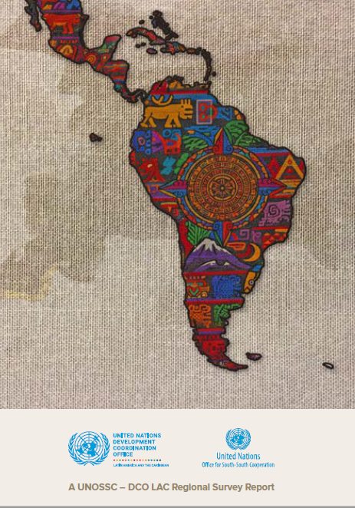
UN System Support for South-South and Triangular Cooperation
in Latin America and the Caribbean
Notes:
---

Slide 2
In alignment with:
BAPA+40 Outcome Document and subsequent Resolutions on calls to the UNDS in line with their mandates and resources to support and promote SSC &TrC in the implementation of Agenda 2030.
01
UN General Assembly resolutions A/Res/76/221, et.al. confirm the importance of UNDS support to SSC &TrC, delivered at the country level and under the leadership of RCs.
02

Slide 3




Objectives of the Report
Why this report ?
To Understand the current landscape
Gain an accurate picture of how South-South and triangular cooperation are being implemented in the LAC region, and the roles they currently play.
To Identify strengths and bottlenecks
Highlight successful practices and comparative advantages, while evidence-based analysis helps pinpoint gaps in institutional frameworks, capacities, coordination, and data systems.
To Improve UN System support
Define priority needs and guide stronger, more targeted support from RCs and UNCTs in advancing South-South and triangular cooperation.
To Shape the way forward
Propose a concrete roadmap, actionable recommendations, and pathways for
expanding cross-regional exchanges toward 2026.

Slide 4
Respondents: Resident Coordinator Offices in LAC
Online data collection via a15-question survey covering 5 broad categories (as below)
Methodolgy
What does the SSC &TrC institutional set-up in LAC prog. Countries look like?
How do UNCTs coordinate SSC &TrC activities?
What is the scope of SSC &TrC partnerships and stakeholder engagement?
What are the challenges and opportunities in supporting SSC &TrC in LAC prog. countries?
Recommendations for a strengthened RC role
24 RCOs incl. 3 MCOs in LAC filled in the Survey
100% response rate.
Notes:
Presenter
2026-01-20 11:50:19
--------------------------------------------
One response per RCO representing the UNCT

Slide 5
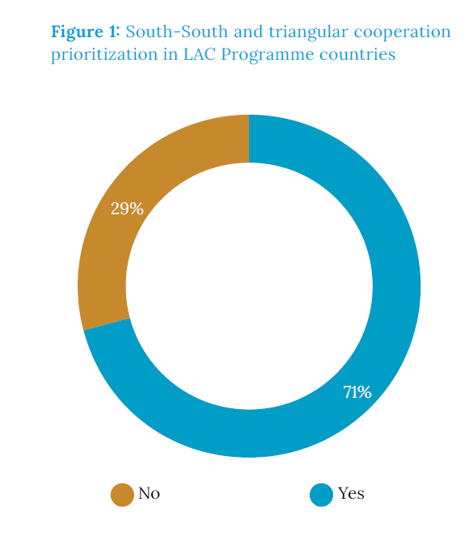
Key Findings – Institutional Setup
On the Alignment with National Priorities
71% of RCOs responded that the host countries officially prioritize SSC & TrC in their national development plans and strategies
However, only 29% of programme countries have integrated SSC & TrC into their CCAs
And, only 75% of priority-setting countries requested UN support on SSC & TrC Issues
Some programme countries requested UN support despite not listing SSC or TrC as priorities (e.g. Chile, Dominican Republic, Honduras).
Notes:
The findings highlight:
A significant gap in the systemic analysis of SSTC opportunities during the diagnostic phase of UN programming,
The institutional gap between stated priorities and actual implementation and,
A degree of misalignment between policy documents and real demand
This suggests that the RCO and UNCT to take a more proactive role in identifying government demand and practical implementation as well as an opportunity for greater institutional anchoring for SSC & TrC and alignment between policy documents and real demand.

Slide 6
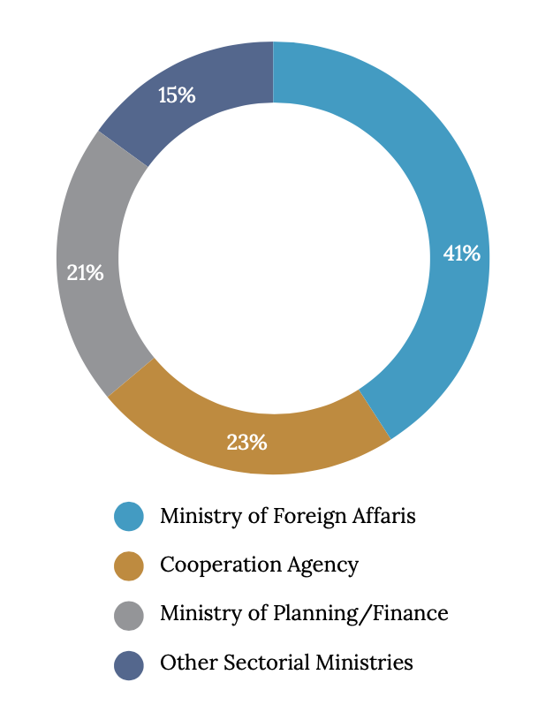
Key Findings – Institutional Setup Cont.
Focal Points – critical factor in institutionalizing SSC
41% of RCOs indicated that Ministries of Foreign Affairs
play a central role as the focal point
Several RCOs adopt a Multiple-Institutional Coordination and Engagement Approach where more than one Govt Institution is engaged on SSC &TrC issues
technical assistance (advice, training)
facilitation of knowledge and people to-people exchanges
partnership facilitation and brokering
Top 3 Support Requests
Notes:
Report indicates that the more governments prioritize South-South and triangular cooperation
the more likely they are to designate a dedicated focal point, and the more actively they request UN support

Slide 7

UNCT Coordination
79% of respondents reported that SSC and TC are managed independently within each agency
29% of respondents reported both agency-level and joint programming approaches under RCO coordination
Example: The Gran Chaco Transboundary Initiative
Gran Chaco is an exemplary case of the joint programming
led by the RCs and UNCTs of Argentina, Paraguay, and Bolivia.
It also has involved different UN agencies, specifically UNEP and UNDP, alongside non-state actors such as civil society organizations, academia, and the Organization of American States (OAS) acting as a supportive regional executing agency.

Slide 8
Findings:
Partnerships and Stakeholder Engagement- Scope and Diversity
SSC & TrC partnerships are broad, multi‑level and multi- stakeholder.
National-level engagement dominates: 95.8% of UNCTs support SSC &TrC with national governments — confirming government leadership as central.
Regional (48%) & cross-regional (22%) SSC cooperation is strong showing growing cross‑border collaboration.
Subregional (35%) and subnational/local (40%) engagement highlight increasing efforts to localize the SDGs and broaden participation beyond national capitals.
A Notable Example is Colombia that reported engagement across all five levels, demonstrating a highly diversified cooperation landscape
Notes:
None State Actors: Civil society & academia: most frequently engaged (>50%).
Private sector: expanding in tech transfer & innovation.
Regional associations: CANARI, OAS, CELAC, SICA.
UN agencies involved: WFP, UNDP, UNICEF, UN Women, ILO, FAO, UNOPS, PAHO/WHO, UNODC

Slide 9
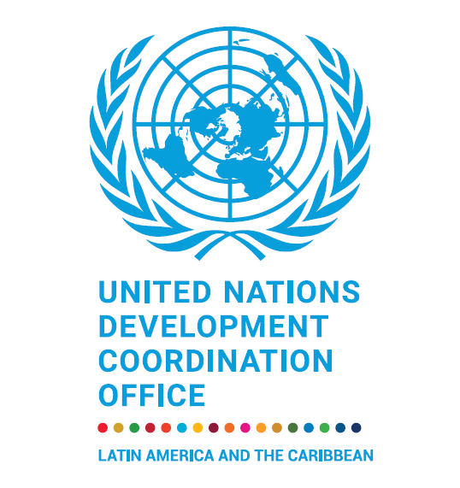





Identified Needs
Additional Resources
Capacity
Building
Broader Partnerships
Knowledge Hub
Development
Improved
Monitoring and Data
More dedicated and
Flexible resources to
support South-South
and Triangular
Cooperation
Capacity Building for UNCT Staff on Relevant tools
Policy and technical support for national partner
Expand and diversify
partnerships
e.g. digital
matchmaking platform
Develop interative
knowledge hub to map
cooperation
opportunities by theme
Strengthen monitoring frameworks and data systems for more effective impact tracking and scaling

Slide 10

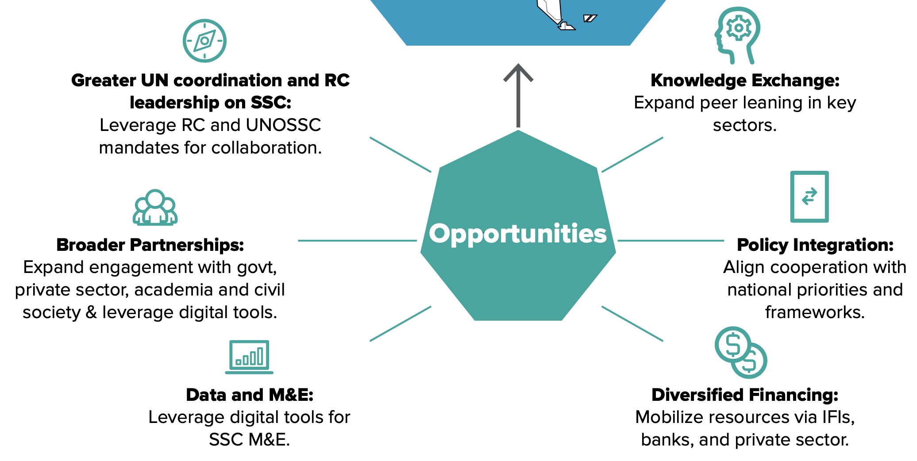
Identified Opportunities
Notes:
71% of programme countries in the region have not yet integrated South-South and triangular cooperation into their CCAs,
which highlights a significant gap in the systemic analysis of South-South and triangular cooperation opportunities - during the diagnostic phase of UN programming

Slide 11


Recommendations to Advance
SSC and TrC in LAC
1
2
Leadership and System-wide
Coordination
Knowledge Sharing and Learning Ecosystem
Reinforced RC leadership leverages to convene stakeholders at all levels.
Reduced duplication and ensured coherence through institutionalized inter-agency coordination.
Systematic integration into national/regional strategies and UN Cooperation Frameworks, aligned with SDGs and country priorities.
Expanded use of digital platforms for exchange, matchmaking, and peer learning.
Capacity development through e-learning and stocktaking tools.
A regional SSC and TrC knowledge management ecosystem linking actors and expertise.
Notes:
Leadership and System-wide Coordination
- Reinforced RC leadership with practical tools and resources to convene stakeholders and advance SSC and TrC at all levels.
- Institutionalized inter-agency coordination to reduce duplication and ensure coherent, collective SSC and TrC outcomes.
- Systematic integration of SSC and TrC into national and regional strategies and UN Cooperation Frameworks, aligned with SDGs and country priorities.
2. Knowledge Sharing and Learning Ecosystem

Slide 12


Recommendations to Advance
SSC and TrC in LAC
3
4
Partnerships, Financing, and Implementation Capacity
Monitoring, Evaluation, and Reporting Systems
Predictable and sustainable SSC and TrC financing.
Strengthened partnerships to scale impact.
Tailored technical training for UNCTs and government counterparts.
Enhanced inter-agency data integration.
Standardized SSC and TrC indicators, outputs, and reporting templates, a unified M&E framework.
Notes:
Leadership and System-wide Coordination
- Reinforced RC leadership with practical tools and resources to convene stakeholders and advance SSC and TrC at all levels.
- Institutionalized inter-agency coordination to reduce duplication and ensure coherent, collective SSC and TrC outcomes.
- Systematic integration of SSC and TrC into national and regional strategies and UN Cooperation Frameworks, aligned with SDGs and country priorities.
2. Knowledge Sharing and Learning Ecosystem

Slide 13

Conclusion: Key Takeaways
The region is structurally ready to scale.
The UN’s comparative advantage is catalytic coordination.
The toolbox exists — mainstreaming is the next frontier.
Scaling requires systemic solutions.
Notes:
Leadership and System-wide Coordination
- Reinforced RC leadership with practical tools and resources to convene stakeholders and advance SSC and TrC at all levels.
- Institutionalized inter-agency coordination to reduce duplication and ensure coherent, collective SSC and TrC outcomes.
- Systematic integration of SSC and TrC into national and regional strategies and UN Cooperation Frameworks, aligned with SDGs and country priorities.
2. Knowledge Sharing and Learning Ecosystem

Slide 14
Official Launch of the Report: 18th Feb 2026
(virtual and co-hosted together with DCO LAC)
UNOSSC-DCO LAC Working Session on the Recommendations from the Report and Way Forward
(Q1- Last week of Feb 2026/ Date TBD)
Presentation of Report Findings – Inter-Agency Mechanism
(Q1 – Date TBD)
Next Steps
Cross-Regional Dialogue on the Report Findings
(Q2- Date TBD)
Joint Comms and Advocacy (ongoing)
Notes:
Leadership and System-wide Coordination
- Reinforced RC leadership with practical tools and resources to convene stakeholders and advance SSC and TrC at all levels.
- Institutionalized inter-agency coordination to reduce duplication and ensure coherent, collective SSC and TrC outcomes.
- Systematic integration of SSC and TrC into national and regional strategies and UN Cooperation Frameworks, aligned with SDGs and country priorities.
2. Knowledge Sharing and Learning Ecosystem

Slide 15


Focal Points for the Report
Cynthia Olouasa (UNOSCC)
cynthia.olouasa@unossc.org
Alina Gievskaia (UNDCO LAC)
alina.gievskaia@un.org
Scan to Access the Publication

